Slide 1



Master Facilities Plan-Tool development
Hongbo Chi 2/22/2021
Notes:
System model and architecture should be given to Danny
Make all of the facilities
Show why are we doing this. What are we looking for.
Tell the story on why we are building this.
Why are we doing this?
What analysis and busies process will this approve.
Outcome from the app.
Need a better solution for having this.

Slide 2
Objectives
Developing tool to assess maintenance facility of MARTA bus transit needs associated with system expansion
Existing bus facilities evaluation/optimization
Allocating buses for bus expansion
New facility site selection

Slide 3
Improvements
Calculating deadhead miles based on block
Original trip-based model detecting waiting time> 15 mins as deadhead
New version can directly identify the deadhead for each block without explicit assumption from users
Dynamically retrieving the street distance based on OSRM local server, instead of the original static method.
Proposing a rigorous optimization model for bus allocation (block based), with the potential for site selection, comparing with original heuristic method.
Integrating the bus bay utilization calculation in the model script from spreadsheet table.

Slide 4

Methodology
Deadheads and revenue miles
Facilities
Operations
Maintenance
Bus reallocation
Bus bay utilization
Notes:
This method framework was developed by kai and yu-chu

Slide 5
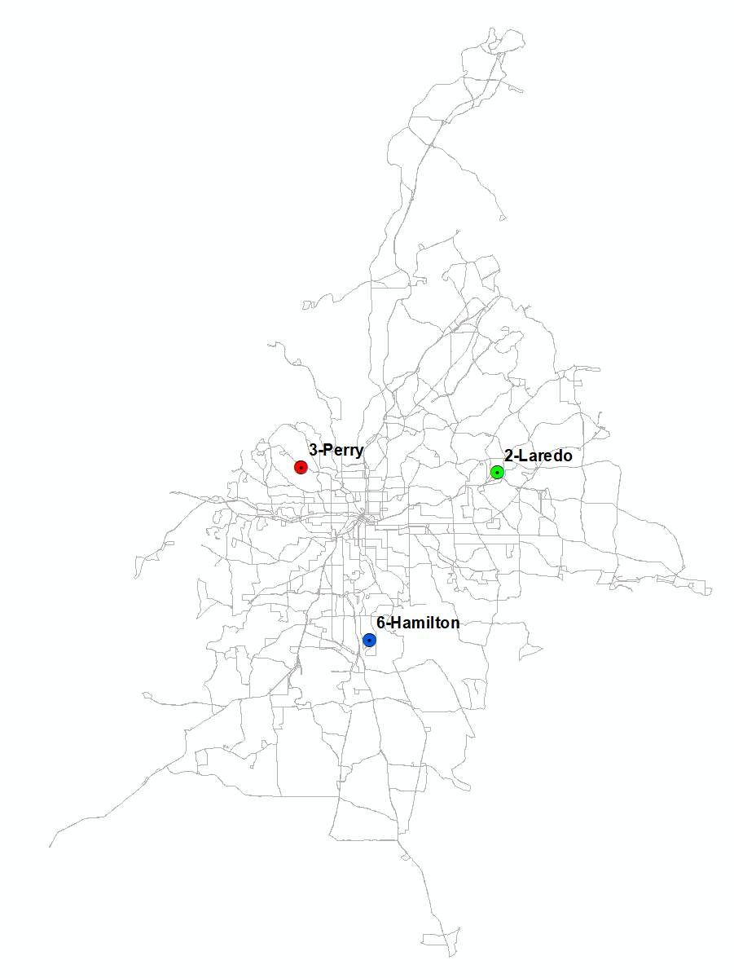
GTFS and Facilities Map
facility | capacity | bus bay | alias | ft_long | ft_lat
2-Laredo | 281 | 20 | A | -84.26734 | 33.78336
3-Perry | 227 | 19 | B | -84.44157 | 33.79004
6-Hamilton | 158 | 16 | C | -84.38432 | 33.66354
Notes:
We used MARTA GTFS 2019 before Covid, without considering Light rail and Heavy rail. We only consider three maintenance facilities Laredo, perry and Hamilton, the location and capacity information is listed in the table, which serves as the constraints for the later bus reallocation model

Slide 6
Revenue miles & Deadhead miles
Notes:
Revenue miles and deadhead miles calculation is very straight forward, based on the GTFS file and route division file (MARTA original assignment of the bus to each facilities)
1.Extract terminal points for each block
2. Set up open street map local server
3. Calculate shortest path between terminal point and facilities as deadhead head
4. Calculate revenue mile

Slide 7
Block Information from GTFS
Block refers to the work assignment for a single vehicle for a single service workday
Route 1
Route 2
Trip 1.1
Trip 1.N
Trip 2.1
Trip 2.M
Block 1.N.1
Block 1.N.X
Block 2.M.N
Interlining block

Slide 8
Deadhead and Revenue Mile Calculation
Deadhead miles=distance between bus terminal and assigned facilities + distance for interlining (a block operating on more than one bus)
Revenue miles = sum of the distance of all trips in the timetable of GTFS file
Total miles= Deadhead miles+Revenue miles
Pull-in deadhead
Interlining deadhead
Pull-out deadhead
Trip A
Trip B

Slide 9


Street distance from OSRM (Open Street Routing Machine)
A powerful and efficient routing machine for engine to solve shortest paths in road networks. Free!
Install Docker in computer (Windows OS)
Download GA OSM.PBF file from (http://download.geofabrik.de/)
Start local OSM local server with docker(http://localhost:5000/route/v1/driving/79.56,6.78;80.21,6.345)
Use Python script to retrieve the shortest distance from local service

Slide 10
Deadhead & Revenue Mile Results
 | Deadhead miles | Revenue miles | Total miles
NTD | 12,016 | 81,560 | 93,576
GTFS method | 11,540 | 87,554 | 99,094
Diff% | -4% | 7% | 6%

Slide 11
Bus Reallocation Model

Slide 12
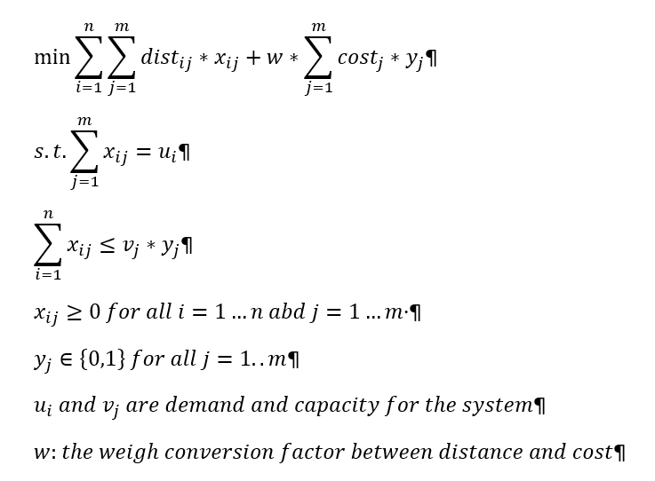
Bus Allocation Algorithm
Modified capacity constrained optimization problem (potential for site selection)
Objective function: combined deadhead miles and facility operation cost
Demand constraint
Supply/Capacity constraint

Slide 13
Bus Bay Utilization

Slide 14
Bus Maintenance Factor
Category | Variable | Current value
General | Working days per year | 250
Annual Schedule Services per Vehicle | Inspections per year | 6,000
 | Engine Tune-Up | 36,000
 | Mid-Life Overhaul | 260,000
 | Inspection duration(hours) | 8
 | Engine tune-up duration (hours) | 8
Mechanical Failures | Major Mechanical Failures per Million Vehicle Miles | 264
Split between division & Browns Mill (to handle mechanical failures) | Division | 0.5
 | Browns Mill | 0.5

Slide 15
Facility/Bus Bay Utilization Results
Existing bus Allocation
Facility | Bbay utilization% | Ft utilization% | Deadhead miles | Total miles
2-Laredo | 83% | 87% | 4,766 | 37,846
3-Perry | 78% | 86% | 4,363 | 33,912
6-Hamilton | 75% | 91% | 2,412 | 27,336
Total |  |  | 11,540 | 99,094
Updated bus allocation
Facility | Bbay utilization% | Ft utilization% | Deadhead miles | Total miles
2-Laredo | 92% | 96% | 5,899 | 42,272
3-Perry | 60% | 67% | 2,328 | 25,964
6-Hamilton | 83% | 100% | 2,805 | 30,350
Total |  |  | 11,032 | 98,586
Bus allocation comparison
Facility | Bbay utilization% | Ft utilization% | Deadhead miles | Total miles
2-Laredo | 10% | 10% | 1,134 | 4,426
3-Perry | -18% | -19% | (2,034) | (7,948)
6-Hamilton | 8% | 9% | 392 | 3,014
Total |  |  | (508) | (508)

Slide 16
Summary
A pilot tool was developed for MARTA for master facility planning purpose:
Extract deadhead/revenue miles from the latest available GTFS files
Can evaluate the existing facility status and improve the bus allocation to reduce deadhead miles
Have the potential for the new facility site location selection with the optimization model
Future works:
Calibrate the bus allocation model based on the available data
Site selection(facility operation cost, model fine tuning)
Bus bay utilization by difficult energy type, and integrating Bus bay capacity constraint to the bus allocation model

